Slide 1
SI 501 F21: Week 6 Agenda
Quarter-Term Feedback
Work models
Microaggressions
Assignments
Interview protocol review
Interpretation session review
Upcoming assignments

Slide 2
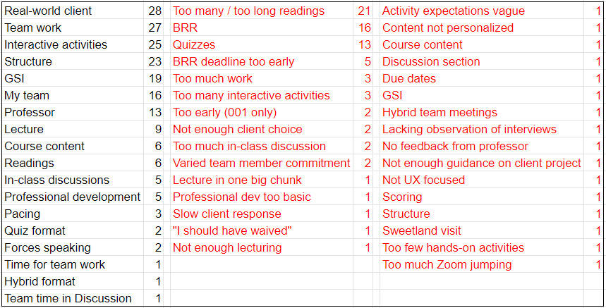
Quarter-Term Feedback Results
Liked
Disliked

Slide 3
You’ve benefited from past students’ feedback.
Before…
Team selection was entirely random, with no option to group with students with similar/different interests.
There were 22 readings, not 12, and many of the 12 were longer versions (See for yourself! http://bit.ly/si501w15syl)
Quizzes did not include the 5-point baseline.
Quizzes were held live in Lecture; students had 6 minutes to complete.
Lectures were 3 hours long (and Discussion was still 1 hour).
Lectures were actual lectures, with minimal discussion and very few activities.
There was no waiver option.
Some lectures started at 8:30am.

Slide 4
Responses to Feedback
Quizzes (13)
Will continue in same format, but we will drop your lowest score when computing quiz averages at the end of the semester.
BRR deadline too early (5)
If you need an extension (even at this point), don’t hesitate to ask!
You will have an opportunity to revise and resubmit.
If you had comments like the following, please don’t hesitate to contact your GSI or me – in class, by email, or at office hours.
“It’s not always clear what we should be doing in in-class activities.”
“I need more direction for my Background Research Report.”
“Provide timely feedback for everything.”
“I was [hoping the MSI] would be more philosophical learning, than practical learning.”
Etc.

Slide 5
Cannot / Will Not Change…
Too many / too long readings (21)
Will continue in same format, but you’ve already completed 7 out of 12 readings. There are only 5 more, of which two are very short, and none are as long as Weiss.
BRR too long / not meaningful (16)
Can’t change now, but when you get to final reports, many of your BRRs will become useful.
Too much work (3)
University expectation is that a 3-credit class will be 3 hours of class per week + 9 hours of work outside of class.
It’s impossible to make everyone happy all of the time…
“I wish there was a bit more lecturing.”
“I would like more hands-on activities in class.”
“[For quizzes] I would suggest short essay questions.”
“I would not change the quiz format.”
“It would be nice if discussions were all team time.”
“The discussion section feels very unstructured.”
“I’m not learning anything new in this course.”
“I like almost everything about SI 501.”

Slide 6
Requests from Us
View 501 assignments as practice for professional knowledge work:
Engaging with real clients / problems
Influencing others without explicit authority
Reading a lot in a short amount of time
Writing a lot in a short amount of time
Identifying and remembering key details
Synthesizing, compressing, and generating new information from other sources
If the course is redundant for you or seems irrelevant…
Hopefully, there will still be relevant material later in the course.
Your mastery course instructor believes SI 501 is a pre-requisite. (That’s not our decision!)
In the future, consider course waivers.
Look for growth opportunities in class: take on the more challenging tasks in your team; step in to improve team dynamics; see whether you can help / mentor your team members do better at their own work; etc.
Do NOT hesitate to…
stay after Lecture to ask questions,
ask questions by email,
go to office hours, or
schedule meetings with your GSI, Anthea, or Kentaro.
We can’t know you have questions / challenges unless you tell us!
Please understand that we have an extremely diverse cohort. We could split up SI 501 into several smaller courses that could be further tailored to different groups, but that would also mean that we have to give up a similar number of courses from elsewhere in the curriculum.

Slide 7
Thanks for Empathetic and Growth-Mindset Comments!
“I would not change the quiz format, since it motivates me to read the material in detail.”
“I understand that the readings are helpful for our interviews and writing reports.”
“I am grateful that 501 is so much more about learning than the pressure of getting the grades.”
“It can't really be changed since it's a me thing! I haven't done much group work before, so this is all just practice/"growing pains" for me.”
“I will try to express my viewpoints more frequently.”
“I wouldn’t change anything, though. I think it's part of the learning process.”

Slide 8
The One Best Thing You Can Do Right Now, to Get the Job You Want Later
Find ways to do the job that you want (or parts of it) right now.
This is why the MSI/MHI programs stress internships.
Doing smaller versions of the desired job is also worthwhile – course assignments, design jams, data dives, part-time jobs, etc.
Until you can get paid to do something, you might have to volunteer to do it.
What if you eventually want to be a manager or a leader?
Find opportunities to serve as a leader. The more leading and managing you do (and do reflectively), the better you will become at it. Don’t wait for someone to ask.
Managing/leading without actual authority is the hardest. If you can do it well, managing/leading with authority is relatively easy.
You can also learn a lot about being a good manager/leader by being a good follower; many leaders were previously someone else’s Number 2.
Employers want to hire someone who is already qualified for the job. “Potential” is great, but demonstrated ability is much less risk for the employer.
Common interview question: “Can you tell me about a time when you [did something like the job you’re interviewing for]? What challenges did you run into, and how did you handle them?”
How this might apply to SI 501: Every team or client interaction is an opportunity – to demonstrate teamwork, client engagement, etc. – especially if challenging issues arise.

Slide 9
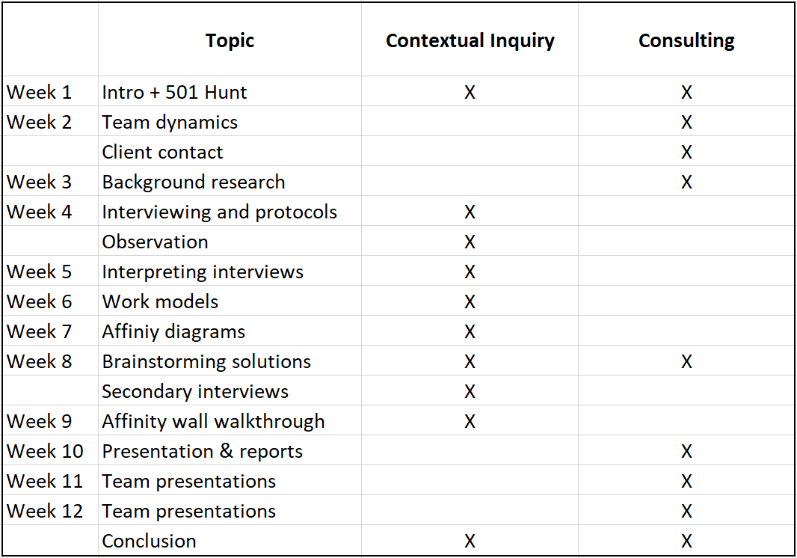
Course Overview

Slide 10
“Work Models”
A “work model” (Beyer & Holtzblatt 1997) is just a visual diagram that is relevant to your project/problem that helps to visualize things.
Use work models to visualize things where it makes sense…
During interpretation sessions;
As you construct your affinity wall;
In your final report.
Beyer & Holtzblatt identify five work models, but don’t feel limited by them.

Slide 11
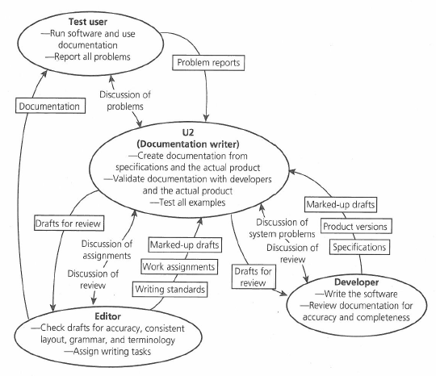
What do the ellipses mean? The rectangles? The arrows?
How many (kinds of?) people does the Documentation Writer interact with?
Which relationships seem to be the most intensive / important?
What are the kinds of interactions that happen between the Documentation Writer and others?
What actions happen without the Documentation Writer’s knowledge?
Flow Model
Source: Beyer & Holtzblatt (1997), Chap. 6

Slide 12
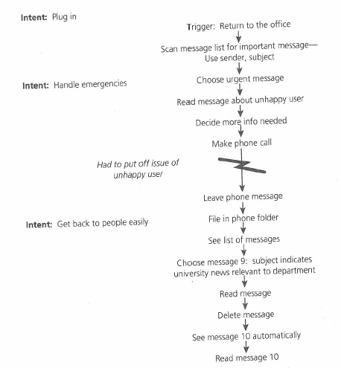
What does the list at right (with arrows) represent?
What else is indicated in this model?
What is the point of the other elements in the mode?
What, if anything, does this model reveal about the work flow?
Have you seen other visualizations that illustrate information in a similar way? What are other names for a “sequence model”?
Sequence Model
Source: Beyer & Holtzblatt (1997), Chap. 6

Slide 13
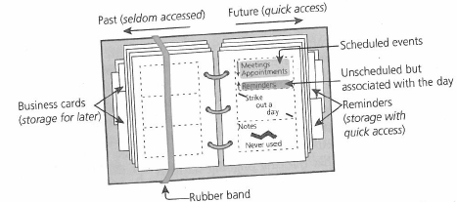
What are all of the things that this notebook is being used for?
What might be the purpose of the rubber band?
What potential problems might the user of this notebook have?
In what ways might this diagram deviate from reality?
How are those deviations helpful for understanding?
Artifact Model
Source: Beyer & Holtzblatt (1997), Chap. 6

Slide 14
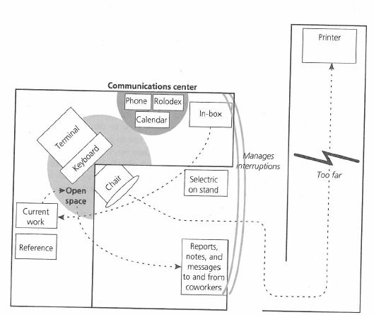
Where is the entryway to the cubicle, and what can you tell about it?
What are some problems faced by the employee that this diagram makes clear?
How could the layout of the physical space be improved?
What might be a more effective way of communicating the problems to someone else?
Physical Model
Source: Beyer & Holtzblatt (1997), Chap. 6

Slide 15
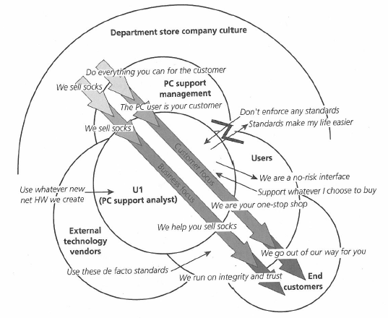
What are the different groups being represented in this diagram?
Where might the individual comments (e.g., “We sell socks”) come from?
What stands out in this diagram? What does it tell you about the culture of this organization?
What might this diagram look like if the culture were different? E.g., what if customer focus was not a central concern?
Culture Model
Source: Beyer & Holtzblatt (1997), Chap. 6

Slide 16
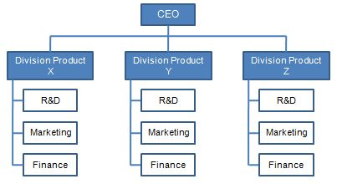
What forms the bluish parts of this diagram?
What can you assume about the straight dark blue lines?
Where might the information behind the red and black text/lines come from?
If your goal (as consultant) is to help the Big Customer get the most out of Division Z’s R&D, what might you suggest to Division X?
Big Customer
Formal client
relationship
Political Model
(Not officially Contextual Inquiry)
Good
friends
Dislike
each other
Has capability
required
by client
Formal client
relationship
Consultant (you!)

Slide 17
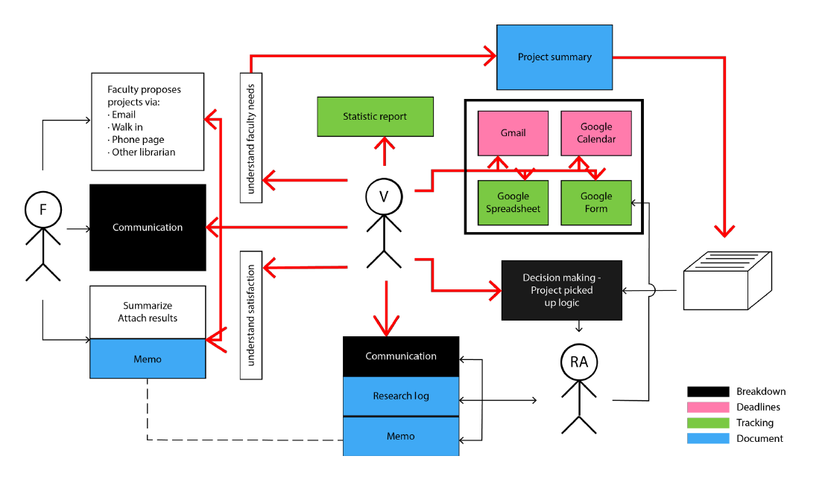
Which person seems to be the most critical to this organization?
Who is involved in all three “breakdowns”?
What might the underlying problem for this organization be?
From Previous 501 Team
Source: Rose Chiang, Kaitlyn Sisk, Lindsay Slater, Abbey Wang

Slide 18
Work Models Summary
Drawing diagrams or images of your findings can help with analysis.
Don’t feel limited by the five types of diagrams described in Beyer & Holtzblatt.
A good diagram tells a story, or clarifies something that is otherwise difficult to understand.
Diagrams can be used in reports and presentations.
For your final report, consider whether a diagram or two might help to explain your analysis.

Slide 19
What is a microaggression?
“The everyday, subtle, intentional – and oftentimes unintentional – interactions or behaviors that communicate some sort of bias toward historically marginalized groups.” (Nadal, 2020)
Examples
“You’re really smart for someone who is X.”
“I’m going to call you Y, because your name is too difficult.”
Excluding someone from a social event because of their identity.
“Your English is so good!” (to someone who grew up in an English-speaking country)
Misgendering – using the wrong pronouns for someone.
Assigning a reading that is offensive to a certain group.

Slide 20
What should you do if you experience or witness a microaggression?
Consider if it’s worth responding:
Is the other person worth it? Do you have reason to believe they will be open to feedback?
Will you regret it if you don’t say anything?
Choose a response type:
Subtly indicate displeasure (e.g., roll your eyes).
Be direct (e.g., “It was offensive for you to say ...”).
Use an “I” statement (e.g., “You probably didn’t mean to offend, but when you said X, it made me feel…”).
Give yourself a chance to process:
Speak with family/friends you trust.
Speak with a professional counselor (e.g., Ashley Evearitt at SI: evearitt@umich.edu)

Slide 21
What should you do if you commit a microaggression?
Accept responsibility and apologize.
Avoid being defensive. Resist any urge to suggest that the recipient of the microaggression shouldn’t have felt hurt, upset, angry, or annoyed.
Learn more!

Slide 22
Resources
Paper that coined the term “microaggression”:
Pierce, C. M., Carew, J. V., Pierce-Gonzalez, D., & Wills, D. (1977). An experiment in racism: TV commercials. Education and Urban Society, 10(1), 61-87. https://journals.sagepub.com/doi/10.1177/001312457701000105
Book that popularized term and concept:
Sue, D. W. (2010). Microaggressions in Everyday Life: Race, Gender, and Sexual Orientation. John Wiley & Sons. https://www.amazon.com/Microaggressions-Everyday-Life-Gender-Orientation/dp/047049140X
New York Times article, with suggestions for responding:
Yoon, H. (2020). “How to respond to microaggressions.” New York Times, Mar. 3, 2020. https://www.nytimes.com/2020/03/03/smarter-living/how-to-respond-to-microaggressions.html
Handling microaggressions at work:
Culture Amp. (n.d.). Microaggressions at work: Recognizing & overcoming our biases. https://www.cultureamp.com/blog/microaggressions-at-work
Kevin Nadal’s guide to responding to microaggressions:
Nadal, K. L. (2014). A Guide to Responding to Microaggressions. CUNY Forum, 2(1):71-76. https://ncwwi.org/index.php/resourcemenu/resource-library/inclusivity-racial-equity/cultural-responsiveness/1532-a-guide-to-responding-to-microaggressions/file
Bystander intervention:
Abrams, Z. (2021). How bystanders can shut down microaggressions. American Psychological Association. https://www.apa.org/monitor/2021/09/feature-bystanders-microaggressions
U-M handout on microaggressions:
Program on Intergroup Relations. (n.d.) Microaggressions: A Primer. https://drive.google.com/file/d/1TK9V_dURx0pJcTnUjQjGw4VnkoDFAxBe/view
UMSI resources:
Devon Keen (devaca@umich.edu), Director of Inclusion, Equity and Outreach
DEI efforts: https://www.si.umich.edu/about-umsi/diversity-equity-inclusion-school-information

Slide 23
Interview Protocols
Generally, very good!
Key points…
Have clear and focused overarching questions.
Make sure the main questions, as a whole, are helping to answer the overarching question.
Focus on concrete, specific instances.
“When was the last time that you did X?” “When do you remember Y happening? Can you walk me through that.”
A LOT can be asked via questions that are concrete and specific.
You can still ask more general questions toward the end of each section. After you understand how a specific case went, you can always ask, “Is that kind of situation typical? Or, would you say that was unusual in some way?”
Though you shouldn’t necessarily ask overarching questions directly, in many cases, you may want to do so. It’s often good to ask them toward the end of the interview.
Interview Protocol Revision – you can get up to 75% of the points you missed by revising and resubmitting by Oct. 25. You are encouraged to resubmit if you got a 92 or less.

Slide 24
Questions or comments about…? Interview protocols Optional revisions due in two weeks. (But, revise them based on feedback as soon as you can for your interviews.) Interview scheduling All scheduled? Interpretation sessions Make sure to do them, so you have affinity notes! If you don’t have affinity notes, you will not do well on the affinity wall part of the course.

Slide 25
Annotated Interview Notes Assignment
See Interview Notes Annotation assignment for details. Due Nov. 1 (in 3 weeks).
Annotate interview notes from one interview in which you were either the interviewer or notetaker.
Scan or photocopy notes, and annotate them in different colored font or ink. Make notes about two different sets of things…
The content of the interview: What was interesting? What was revealing? Etc.
The quality of the interview: What went well? What could have gone better? Etc.
Anything else that occurs to you as you think back to the interview.
At end, write 300-400 words of reflection, focusing on what went well, and how the interview could have gone better. If you can’t think of things that could have gone better, you didn’t reflect hard enough!

Slide 26
Background Research Report Revision
Opportunity to revise and resubmit: Due Nov. 15.
To make it easy for us to see what changes you made, please use “track” or “suggestion” mode, or use a different colored font for anything that you revise.
You’re eligible to make up 75% of the score you didn’t receive.
For example, if you scored an 80/100 this time (missing 20), 75% of 20 points is 15 points, so if you handed in an excellent revision, your final score would be 95.
You are encouraged to resubmit if you scored a 90 or less.
If you do resubmit, however, please take the revision seriously. It requires additional effort on our part to grade.
Any points you lost for lateness cannot be made up.
For example, if you scored a 75/100 of which 5 points was taken off for lateness, then the 5 points stays off regardless of revision. Of the remaining 20 points, you can make up up to 75%, or 15 points.
Grading comments should point you in the right direction.
Read grading comments broadly. If there’s a comment about an issue in one section of the paper, it may apply to other sections of the paper, as well.
As usual, we are happy to provide feedback in advance. Do not hesitate to ask your instructor/GSIs for input.

Slide 27
Survey
One of our GSIs, Halima, is doing a project to identify ways to improve internship support for first-year, UX-focused MSI students.
If you’d like to help, please complete this 3-minute survey:
https://j.mp/UXintern21

Slide 28
A lot coming up (but spread out over weeks)…
Oct. 18
Quiz due on Work Models and the Interpretation Session Guidelines.
No Lecture or Discussion next week (Oct. 18-19) – Fall Break!
Oct. 25
Read the Affinity Wall Guidelines document.
Quiz also due before Lecture.
[Optional] Revised Interview Protocols due before Lecture.
Now through Oct. 29: Make sure you have interviews scheduled. Note-takers, take good notes! Try to complete as many interviews as possible by Oct. 29 (but, up to Nov. 5 for a couple is OK).
Nov. 1: Annotated Interview Notes assignment due.
Nov. 15: [Optional] Revised Background Research Reports due.

